Slide 1
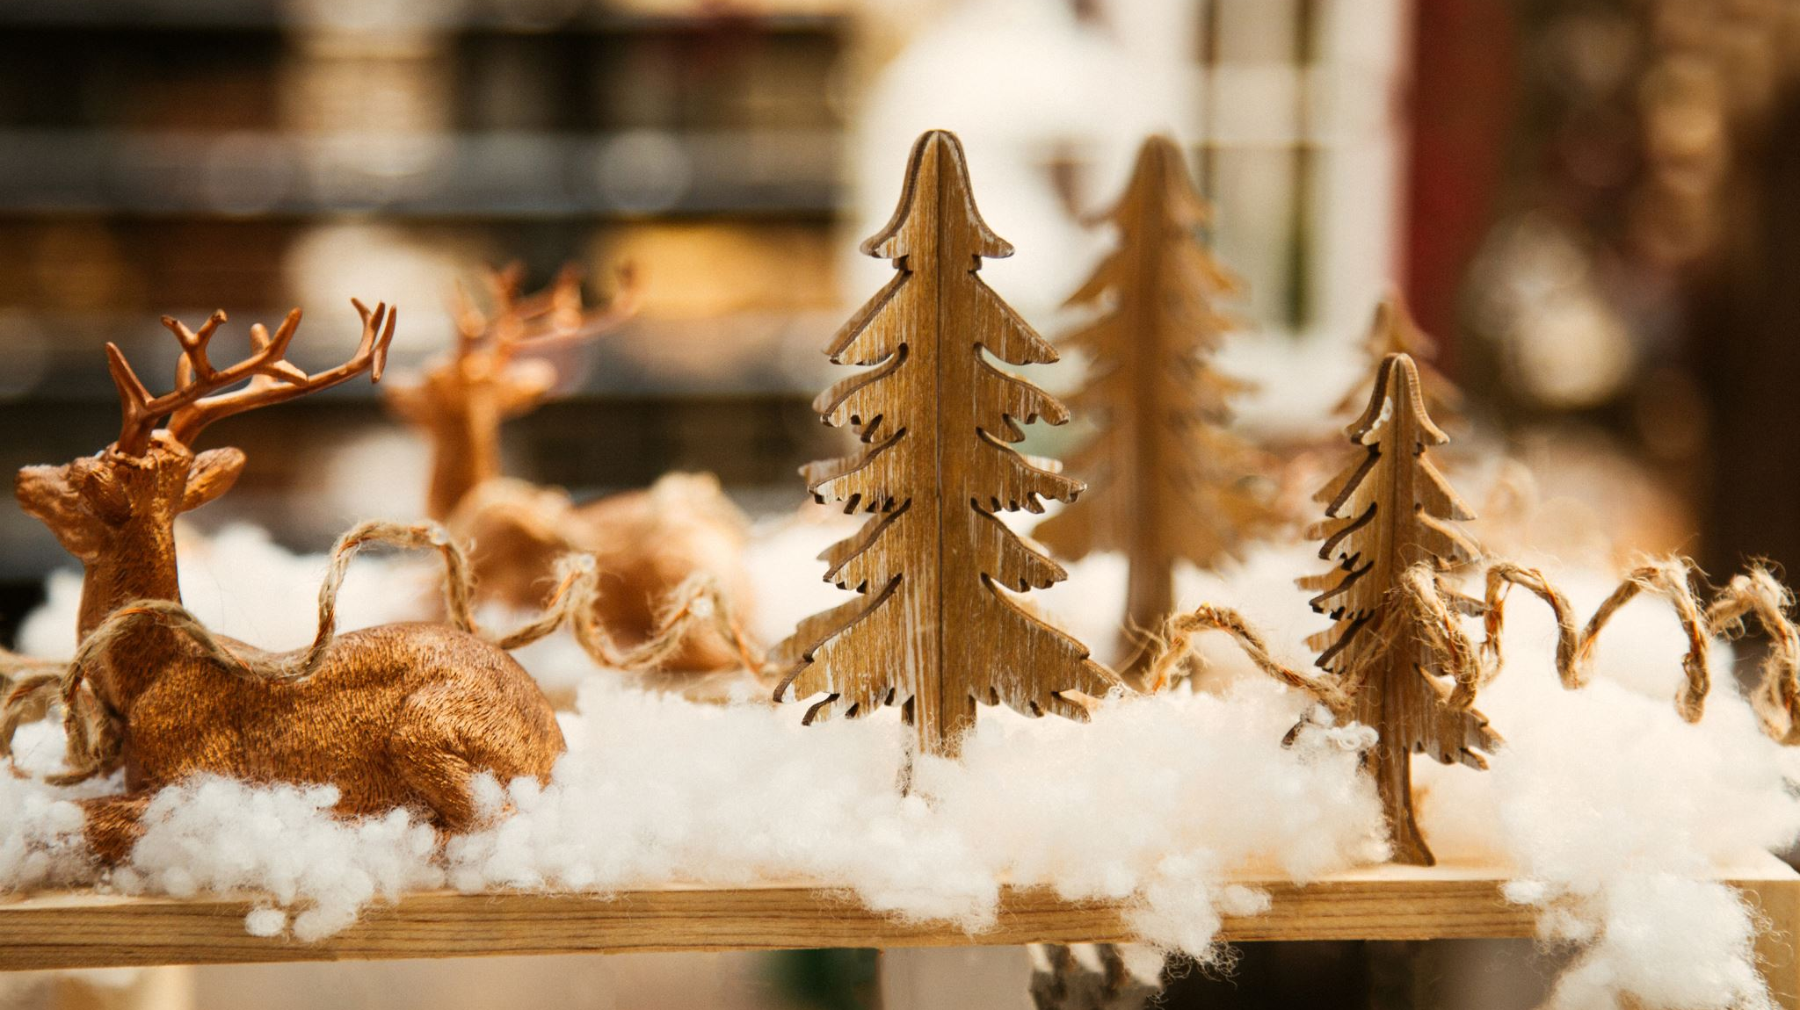
Christmas Jubilation

Slide 2
Christmas Jubilation!
Shine, shine the light of glory.
It’s a celebration.
Ev’rybody sing. (repeat)

Slide 3
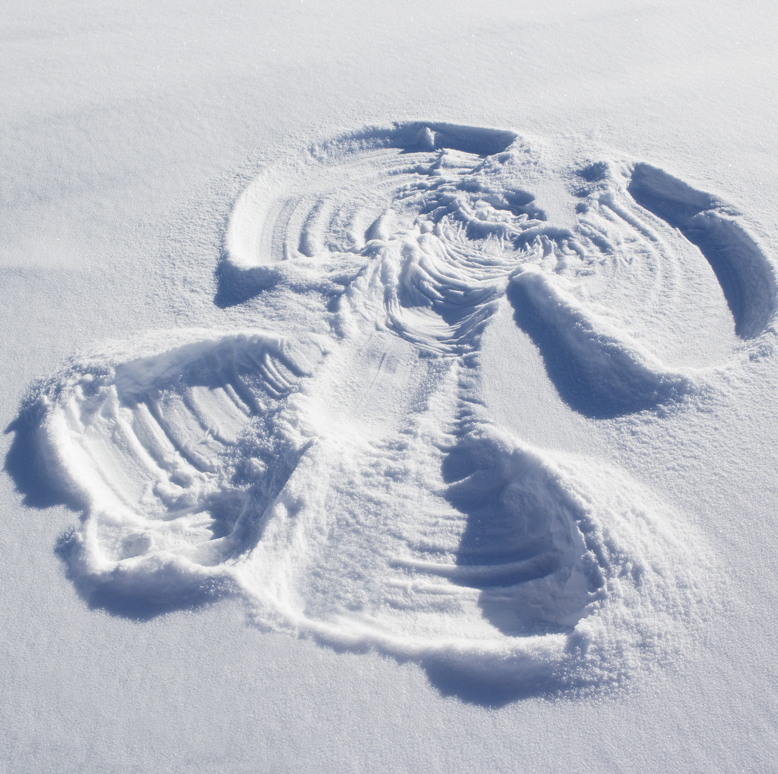
With the angels,
Shout it from the mountains.
Alleluia,
Make a joyful sound!

Slide 4
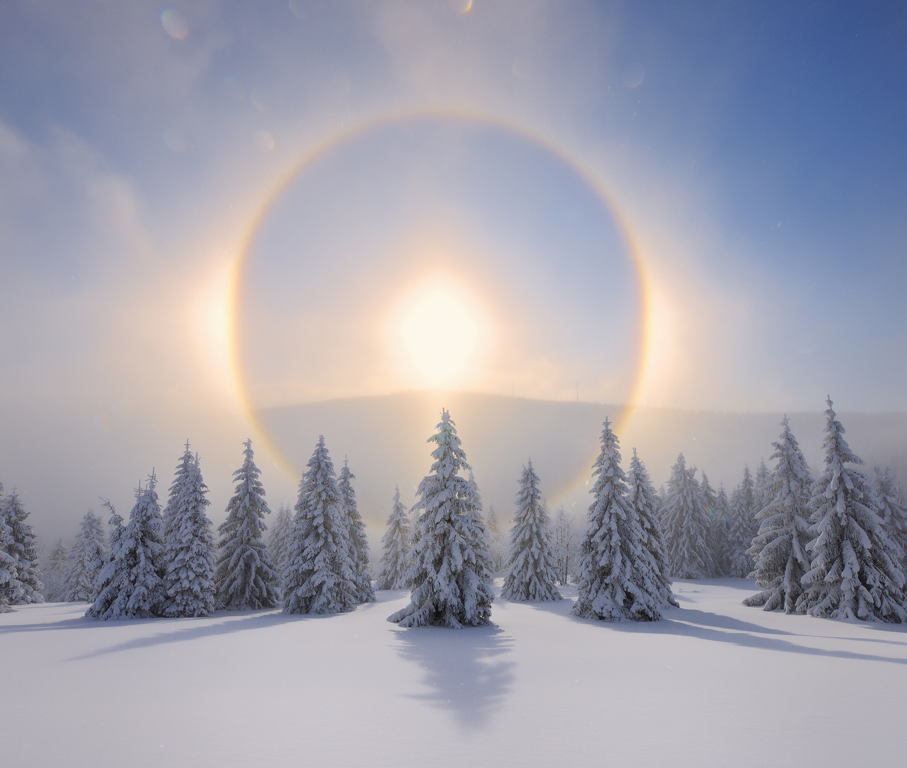
Raise your voices.
Fill the sky with singing.
Alleluia,
Make a joyful sound!

Slide 5
Christmas Jubilation!
Shine, shine the light of glory.
It’s a celebration.
Ev’rybody sing. (repeat)

Slide 6
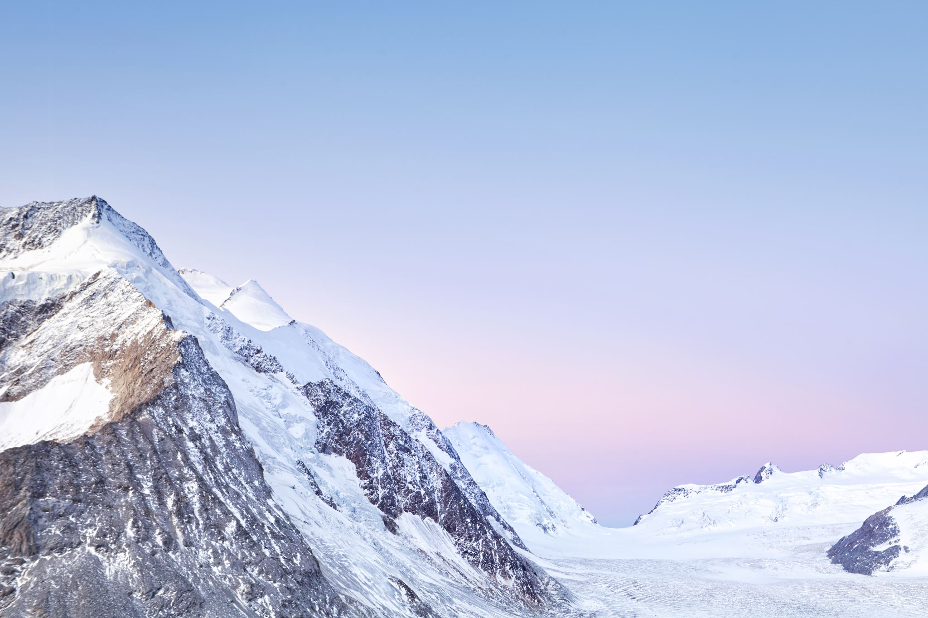
Solo: Ev'rybody
All: Sing
Solo: From the mountains
All: Sing
Solo: To the valley
All: Sing

Slide 7
Christmas Jubilation!
Shine, shine the light of glory.
It’s a celebration.
Ev’rybody sing. (repeat)

Slide 8
Christmas Jubilation!
Shine, shine the light of glory.
It’s a celebration.
Ev’rybody sing-------------------
Ev’rybody sing!
Hey!

